Slide 1

PARKINSON’S DISEASE DATA ANALYSIS BASED ON VOICE
COURSE: NASSCOM FUTURESKILLS DATA ANALYTICS
(NAS1001) CLASS:1028 SLOT : G11 + G12 + G13
FACULTY: DR. PON HARSHAVARDHANAN
TEAM MEMBERS:
Anwesha Ujjwal Barman 18BCE10309 Kritika Shah 18BCE10145
Somya Upadhyay 18BCE10270 Tanmay 18BCE10277

Slide 2
TABLE OF CONTENTS
01
02
03
04
OBJECTIVES
DATASET
ANALYSIS
CLASSIFICATION

Slide 3
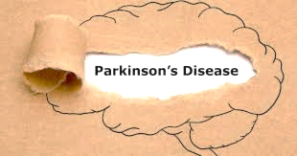
WHAT IS
Notes:
Before we jump on to data analysis and classification, let’s understand →what Parkinson’s Disease, why so much Analysis

Slide 4
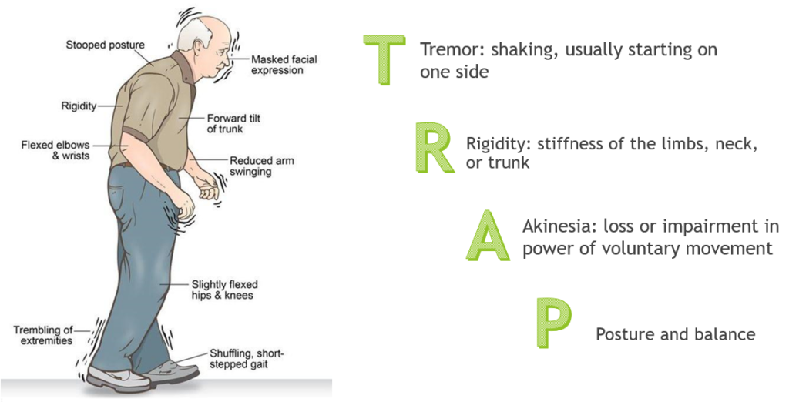
Notes:
Nerve Damage Resulting into these Symptoms

Slide 5

Why So Much Research on this Issue?
As the symptoms become more obvious, people have difficulty walking, talking, or completing other simple tasks.
Early detection can help in proper therapy.
No cure for PD exists today, but research is ongoing and medications or surgery can often provide substantial improvement with motor symptoms.

Slide 6

OUR
OBJECTIVES
To analyze components of voice of people with Parkinson’s Disease.
To classify a person as healthy or as having Parkinson’s Disease.

Slide 7
Data Set
Properties
Type of File : .data file
Number of Attributes per Row : 24
Released Under : UCI Machine Learning Repository (Center for Machine Learning and Intelligent Systems)
Source : https://archive.ics.uci.edu/ml/datasets/parkinsons
Data : https://archive.ics.uci.edu/ml/machine-learning-databases/parkinsons/

Slide 8
Data Set
This dataset is composed of a range of biomedical voice measurements from 31 people, 23 with Parkinson's disease (PD).
Each column in the table is a particular voice measure, and each row corresponds one of 195 voice recording from these individuals ("name" column).
The main aim of the data is to discriminate healthy people from those with PD, according to "status" column which is set to 0 for healthy and 1 for PD.

Slide 9
Attributes in the Data Set
MDVP:
Flo(Hz)
Average vocal fundamental frequency
Name
MDVP:
Fo(Hz)
MDVP:
Fhi(Hz)
Minimum vocal fundamental frequency
ASCII subject name and recording number
Maximum vocal fundamental frequency
MDVP:
Jitter(%)
MDVP:
RAP
HNR
NHR
MDVP:
PPQ
MDVP:
Jitter(Abs)
Jitter:
DDP
Several measures of variation in fundamental frequency
Two measures of ratio of noise to tonal components in the voice

Slide 10
Attributes in the Data Set
Spread1
Shimmer:
DDA
MDVP:
Shimmer
MDVP:
APQ
PPE
Spread2
MDVP:
Shimmer(dB)
Shimmer:
APQ3
Shimmer:
APQ5
Three nonlinear measures of fundamental frequency variation
Several measures of variation in amplitude
RPDE
D2
DFA
Status
Two nonlinear dynamical complexity measures
Signal fractal scaling exponent
Health status of the subject (one) - Parkinson's, (zero) - healthy

Slide 11

Analysing Our Data

Slide 12



Modifying Data File
.data
.txt
.csv
Renaming Columns for better readability

Slide 13
Analysing the Data
If the csv sheet has a data frame : Yes
Number of rows (excluding headers) : 195
Number of columns (attributes) : 24
Is any value NA : No

Slide 14
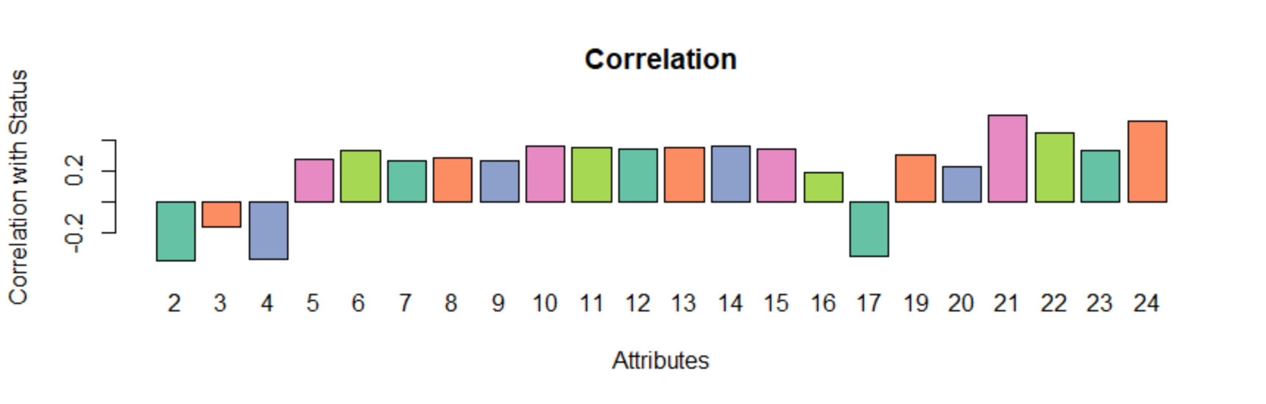
Modifying Data File
Correlation of Each Attribute with the Status (Categorical Variable)

Slide 15
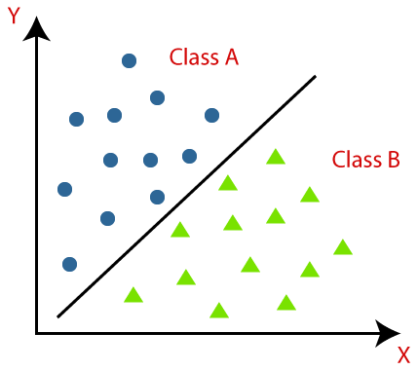
Classification

Slide 16
Prerequisites
Removal of Columns: Names, Absolute Jitter
Names : Columns are ordered
Absolute Jitter : Found to have no variance while training models, and has negligible correlation with the categorical value
Pre-processing: Centering and Scaling
Centering a variable is subtracting the mean of the variable from each data point so that the new variable's mean is 0.
Scaling a variable is multiplying each data point by a constant in order to alter the range of the data.
Partitioning
The train and test data is partitioned into 9:1. At every iteration of training the model, random 10% of data points in the set are selected as testing objects, rest for training.

Slide 17
MODEL 1 : LDA
Linear Discriminant Analysis:
1 = Has Parkinson’s Disease
0 = Healthy
Discriminant Function:
y = ax₁ + bx₂+ cx₃ + dx₄ + ex₅ + fx₆ + gx₇ + hx₈ + ix₉ + jx₁₀+ kx₁₁ + lx₁₂ + mx₁₃ + nx₁₄ + ox₁₅ + px₁₆ + qx₁₇ + rx₁₈ + sx₁₉ + tx₂₀ + ux₂₁ + vx₂₂
P(y=1), P(y=0)
Overall Iterations Score:
Minimum Accuracy: 75%
Mean Accuracy: 83.62%
Maximum Accuracy: 90%

Slide 18
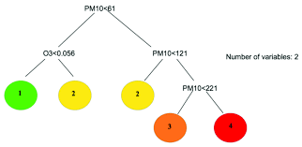
MODEL 2 : CART
A Classification And Regression Tree (CART), is a predictive model, which explains how an outcome variable's values can be predicted based on other values. A CART output is a decision tree where each fork is a split in a predictor variable and each end node contains a prediction for the outcome variable.
Overall Iterations Score:
Minimum Accuracy: 68.42%
Mean Accuracy: 89.47%
Maximum Accuracy: 90%

Slide 19
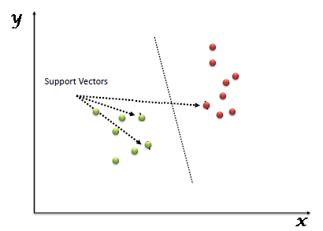
MODEL 3 : SVM
A Support Vector Machine projects the data points virtually in space by taking the features as dimensions and tries to find the line or plane, which separates the data points of different classes.
Overall Iterations Score:
Minimum Accuracy: 78.94%
Mean Accuracy: 88.21%
Maximum Accuracy: 95%

Slide 20
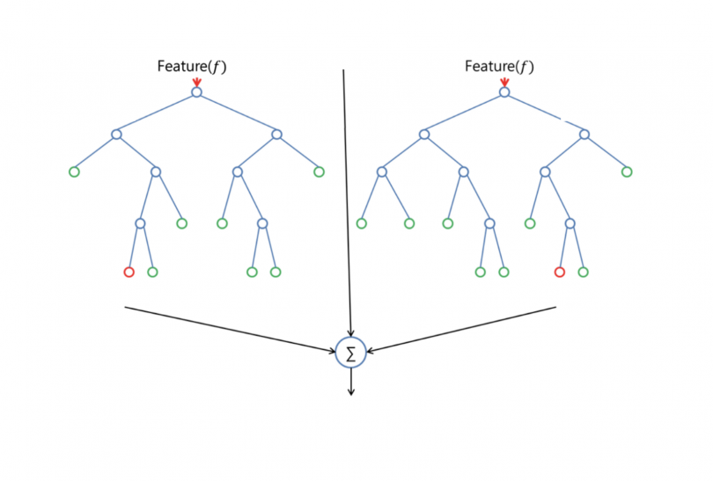
MODEL 4 : RF
Random Forest (RF) builds several decision trees and unites them to get more precision and accuracy.
Overall Iterations Score:
Minimum Accuracy: 84.21%
Mean Accuracy: 91.81%
Maximum Accuracy: 100%

Slide 21
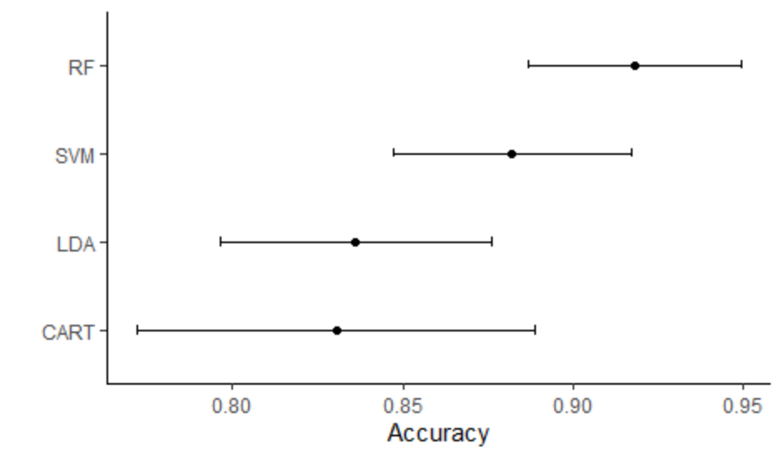
Comparison of Four Models

Slide 22
REFERENCES
Exploiting Nonlinear Recurrence and Fractal Scaling Properties for Voice Disorder Detection', Little MA, McSharry PE, Roberts SJ, Costello DAE, Moroz IM. BioMedical Engineering OnLine 2007
Max A. Little, Patrick E. McSharry, Eric J. Hunter, Lorraine O. Ramig (2008), 'Suitability of dysphonia measurements for telemonitoring of Parkinson's disease', IEEE Transactions on Biomedical Engineering
https://ggplot2.tidyverse.org/reference/ggtheme.html
https://garthtarr.github.io/avfs/caret.html

Slide 23
THANK YOU!

